Slide 1
Diabetes Readmission Prediction
Readmit - None‎‎
Shay Agarwal & Matt Harris
December 16, 2020

Slide 2
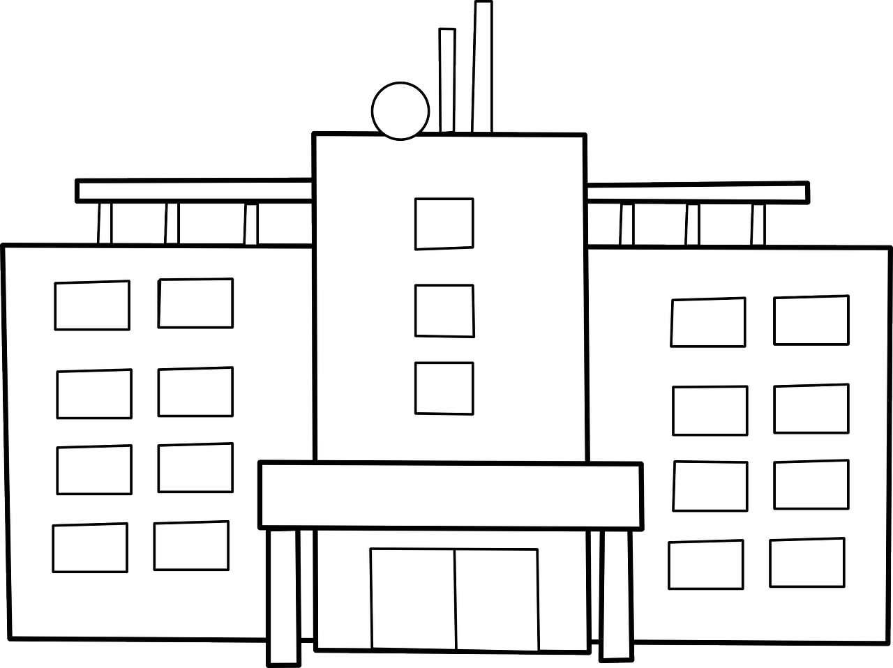


Overview
Hospital readmission rates indicate quality of clinical care
Readmission penalties comprise a large avoidable cost to hospitals
Patients readmitted to the hospital for the same condition within 30 days of the initial stay result in the hospital experiencing a financial readmission penalty
If patients with a high risk of readmission could be targeted for intervention, and readmission avoided, hospitals could save a great deal of money and the quality patient care could be increased
Notes:
Hospital readmission rates for conditions like diabetes are an indicator of hospital quality, and adversely affect the cost to hospitals via readmission penalties.
Patients readmitted to the hospital for the same condition within 30 days of the initial stay result in the hospital experiencing a financial readmission penalty
If patients with a high risk of readmission could be targeted for intervention, hospitals could save a great deal of money and patient care could be increased

Slide 3
Project Objective
Hospital is the primary stakeholder
Clinicians are interested in readmission rates to identify shortcomings in patient care
Finance department wishes to identify areas for cost savings, especially readmission penalties
The intervention team desires a predictive model suitable for these parties
Goal: Create a model that predicts patient readmission in less than 30 days
Model evaluated on AUC, false positive rates, and true positive rates
Designed for use by the intervention team

Slide 4

Business Outcome Objectives
Outcome 1
Outcome 2
Clinicians can more effectively treat patients through preventative rather than reactive medicine
Hospital finance department can reduce the burden on the hospital through lowering readmission penalties, etc.
Notes:
https://revcycleintelligence.com/news/3-strategies-to-reduce-hospital-readmission-rates-costs#:~:text=Identifying%20causes%2C%20enhancing%20transitional%20care,readmission%20rates%20and%20avoid%20penalties.

Slide 5
Process
Data Collection
Data Processing
EDA & Visualization
Modeling & Tuning
Final Result
Data set was self contained; no other data added
Missing Values Data Cleaning Etc.
Features grouped based on readmission rates
Variants of Logistic, Random Forest, and XGBoost explored and tuned for optimization
AUC Decile Analysis Feature Importance Business Conclusions

Slide 6
Understanding the Data

Slide 7
Data Collection
Sourced from UCI
10 years (1999-2008) of clinical care at 130 US hospitals and integrated delivery networks.
Over 50 features representing patient and hospital outcomes.
~ 100,000 records.
Encounters all satisfied the following criteria:
Was inpatient (hospital admission).
Was a diabetic encounter (some diabetes diagnosis)
Length of stay 1-14 days
Lab tests were performed
Medications were administered

Slide 8
Data Preprocessing
3 Major Concerns:
Missing values within desired features
Features with high overall missingness
Multiple encounters per patient

Slide 9
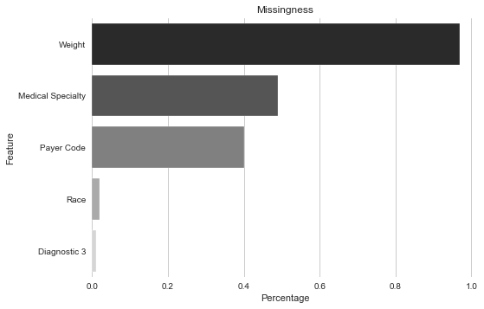
Data Preprocessing
Missingness
3 features have high overall missingness:
Weight, Medical Specialty, and Payer Code
Percent Missing
Weight: 97%
Medical Specialty: 49%
Payer Code: 40%
Race: 2%
Diagnostic 3: 1%
Notes:
First step to load data frame and describe the data set to obtain a better understanding. Next We checked for missingness.
Replace values in the data frame with a “?” with N/A
Removal of multiple encounters per patient. Only first encounter was taken per patient number.
Removal of hospice or expired patients
Removal of unknown gender
Replace missing and unknown values with N/A

Slide 10
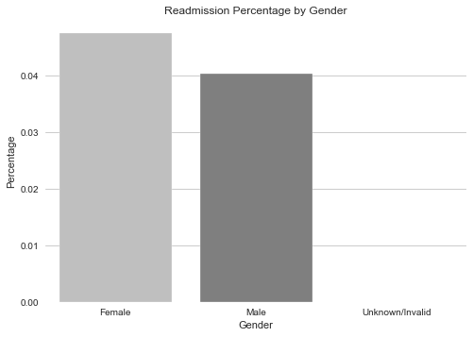
Data Preprocessing
Missing values within desired features:
Removal of “Unknown” gender (3 entries)
Features with high overall missingness:
Removed Weight, Medical Specialty, and Payer Code
Multiple encounters per patient:
Removed multiple encounters, keeping only the first encounter for each patient
Removal of encounter and patient features
Notes:
Replace values in the data frame with a “?” with N/A
Removal of multiple encounters per patient. Only first encounter was taken per patient number.

Slide 11
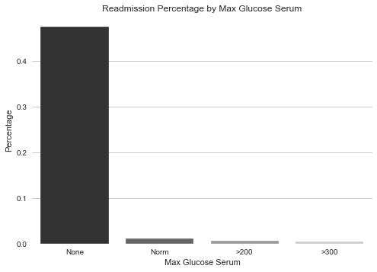
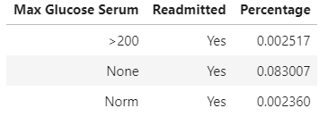
EDA - Max Glucose Serum
Observing Data in relation to readmission
A blood sugar level less than 140 mg/dL (7.8 mmol/L) is normal.
A reading of more than 200 mg/dL (11.1 mmol/L) after two hours indicates diabetes.
A reading between 140 and 199 mg/dL (7.8 mmol/L and 11.0 mmol/L) indicates prediabetes.
Notes:
Groupby with readmitted to inspect percentage of readmitted patients by feature
Target column set to readmitted by changing (<30) to Yes, and all other values to No.

Slide 12
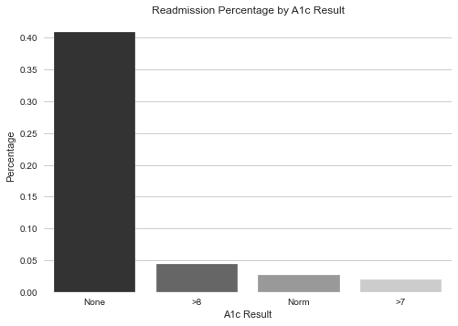
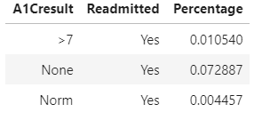
EDA - A1c Results
Observing Data in relation to readmission
A1c test: blood test that reflects average blood glucose levels over a 3 month period
A1c test is sometimes called the hemoglobin A1c, HbA1c, glycated hemoglobin, or glycohemoglobin test.
A1c over 8% indicates poorly controlled diabetes
Notes:
An A1C test is a blood test that reflects your average blood glucose levels over the past 3 months. The A1C test is sometimes called the hemoglobin A1C, HbA1c, glycated hemoglobin, or glycohemoglobin test. Hemoglobin is the part of a red blood cell that carries oxygen to the cells.

Slide 13
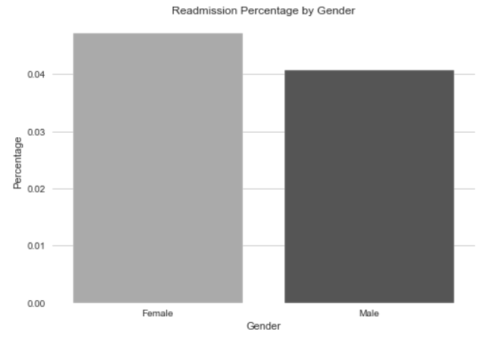
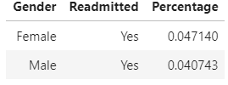
EDA - Gender
Observing Data in relation to readmission
Females shown to have slightly higher chance of readmission within our dataset
However diabetes is more prevalent in males (2.3 %), than in females (1.4 %)
Most likely due to the imbalance of data with more females prevalent in the data than males.

Slide 14
Feature Engineering
Performed with similar goals as EDA, with modelling intentions and outcomes in mind
Addresses high cardinality or other imbalances within the data
7 features grouped to reduce the number of variables post dummification

Slide 15
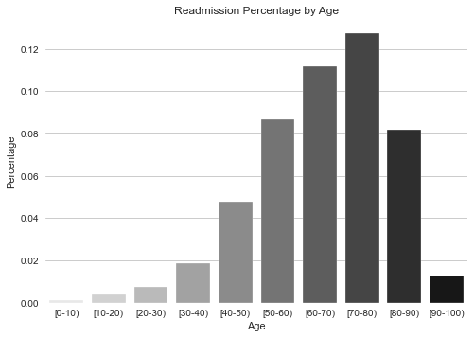
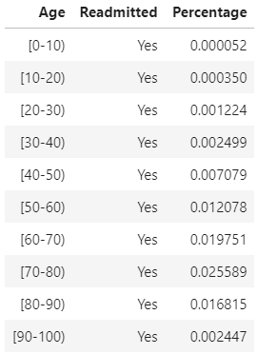
Feature Engineering - Age
Observing Data in relation to readmission
Ages fell into natural groupings based on readmission data as well as typical age/health related milestones
Groupings:
Ages 0-40
Ages 40-90
Ages 90-100
Notes:
** Explain justification for group age into 3 buckets by text how its grouped
Remove table

Slide 16
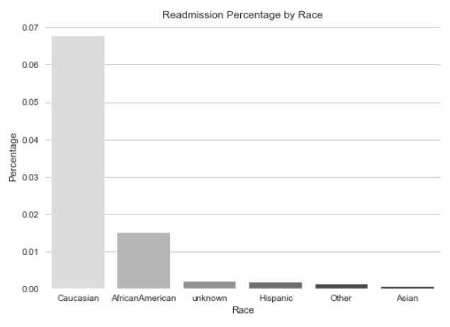
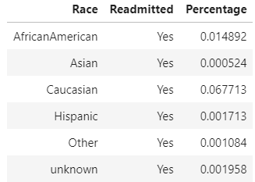
Feature Engineering - Race
Observing Data in relation to readmission
Caucasians shown to have the highest readmittance
Followed by African Americans
Groupings:
Caucasian
African American
Other

Slide 17
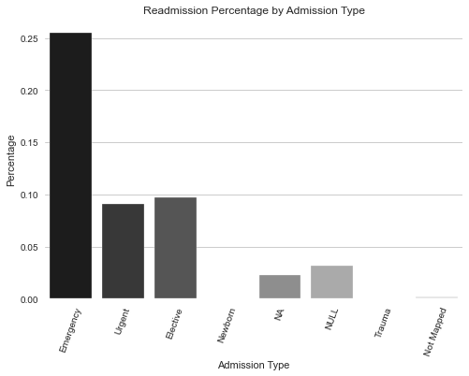
Feature Engineering - Admission Type
Observing Data in relation to readmission
Emergency admission type had the highest readmission rate
Followed by Urgent and Elective
Groupings:
Emergency
Urgent
Elective
Other

Slide 18
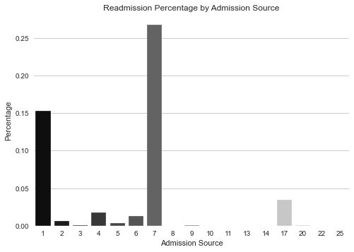
Feature Engineering - Admission Source
Observing Data in relation to readmission
Groupings:
Physician Referral (1)
Emergency (7)
Other

Slide 19
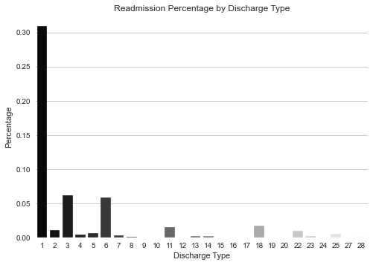
Feature Engineering - Discharge Disposition
Observing Data in relation to readmission
Vast majority of readmission occurred with patients discharged to Home
Groupings:
Home (1)
Not Home

Slide 20
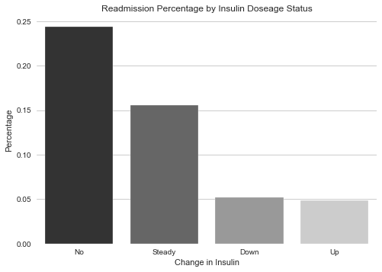
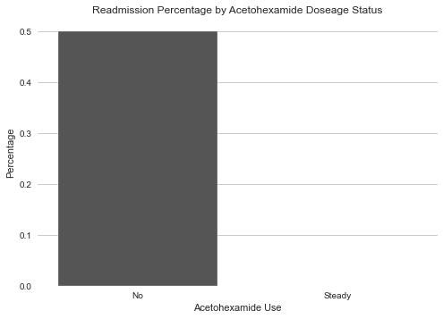
Feature Engineering - Medications
Observing Data in relation to readmission
Insulin: only medication with good representation in status types
Non-insulin medications poorly represented (ex: Acetohexamide)
All non-insulin medications converted to binary: Takes vs Does Not Take

Slide 21
Feature Engineering - Diagnostic Codes
Observing Data in relation to readmission
Individual codes grouped into 9 IDC-9 clinical categories
Symptoms grouped with major categories
Diag_1, 2, and 3 were consolidated into these categories
Result: 9 features >>>
Circulatory
Respiratory
Digestive
Diabetes
Injury
Genitourinary
Musculoskeletal
Neoplasms
Other

Slide 22
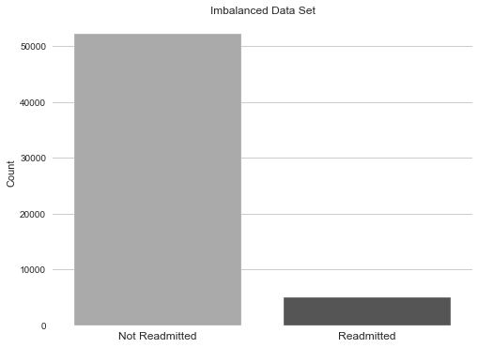
Feature Engineering - SMOTE
Unbalanced Readmission
Data Frame(Test/Train Split):
Total : 71518
Train : 57214 (80%)
Test : 14304 (20%)
Readmission(Before SMOTE):
No : 52178
Yes : 5034
Readmission(After SMOTE):
No : 52178
Yes : 52178
Notes:
SMOTE

Slide 23
Feature Engineering: Feature Reduction
Recursive Feature Elimination w/CV (RFECV)
Estimator: Decision Tree Classifier
Stratified K fold cross validation (5 folds)
Top 45 features selected based on cross validation score
Readmission By Gender (Original):
Male : 0.040871
Female. : 0.047121
Test / Train Split
Performed an 80/20 split (Train/Test)
Saved 20% of the data as hold out
Testing
Readmission scoring
Readmission By Gender (Train):
Male : 0.040445
Female. : 0.047541
Readmission By Gender (Test):
Male : 0.042576
Female. : 0.045442

Slide 24
Model Selection
Logistic Regression
Random Forest
XGBoost
Parameter Optimization

Slide 25
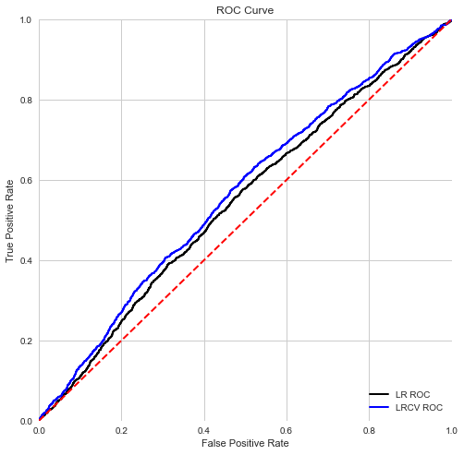
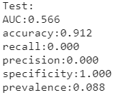
Model Selection - Logistic Regression
LR & LRCV combined charts
Logistic Regression (black)
Produced poor results
AUC: 0.547
Quickly moved on to LRCV
Logistic Regression w/CV (blue)
Better AUC: 0.566
Poor results for feature importance
Poor results for decile analysis
Skewed variables would likely benefit from a more advanced model

Slide 26
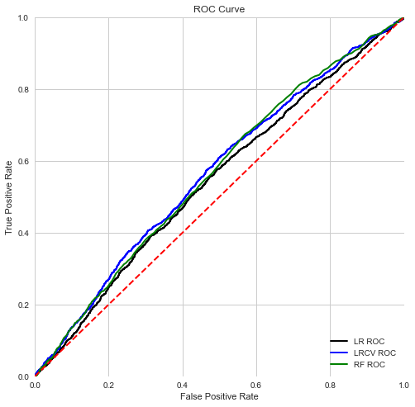
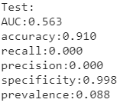
Model Selection - Random Forest
Random Forest Model (green)
Similar AUC: 0.563
Much improved feature importance
Improved decile results
Suspected that some form of gradient boost would improve scores given our data construction

Slide 27
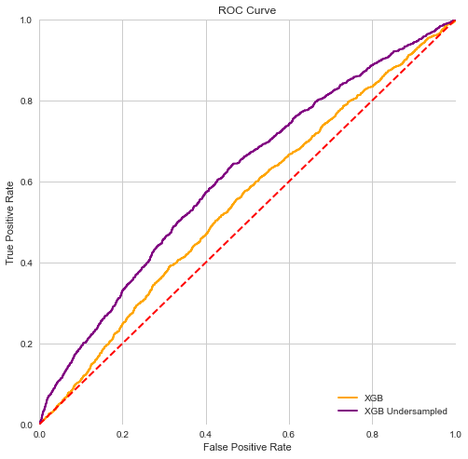
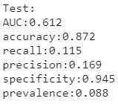
Model Selection - XGBoost
XGBoost (orange)
0.568: highest AUC of base models
Good feat. imp. and dec. analysis
Employed undersampling techniques for classes to further balance the data
XGB Undersampled (purple)
Test results shown
0.612 AUC
Good feat. imp. and dec. analysis
Poor false negative performance

Slide 28
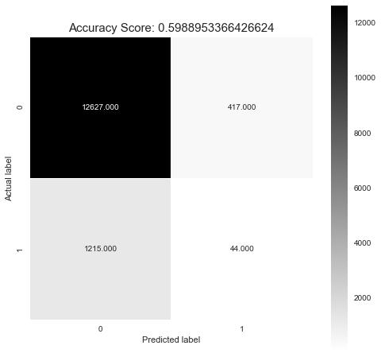
Model Selection - Hyper Parameter Tuning
XGB Undersampled
Large false negative count (1215)
Bad for clinical setting
Bad for unexpected readmission penalties in a financial context
Hyper Parameter Tuning
Performed to minimize false negatives
Used Grid Search Cross validation to retrain
Scored on AUC
5 fold CV

Slide 29
Model Results
Evaluated via:
AUC
Decile Analysis
Feature Importance

Slide 30
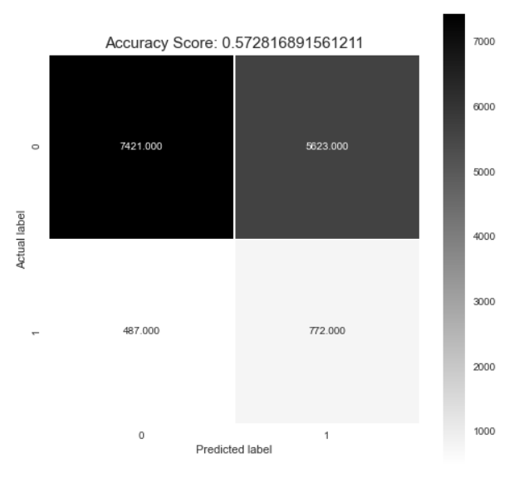
Model Results - XGBoost Tuned
XGBoost Confusion Matrix
Somewhat high false positive count: 5623
Lowest false negative count of all tested models: 487
We considered this an acceptable trade-off for a clinical setting

Slide 31
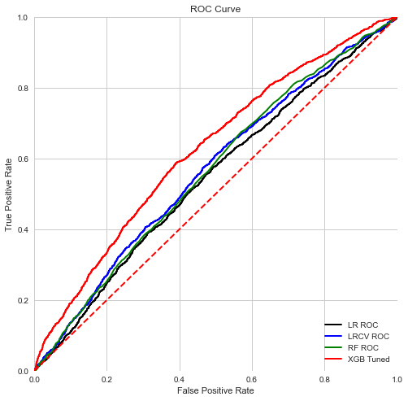
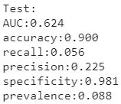
Model Results - XGBoost Tuned
XGBoost Tuned (red)
Best AUC performance: 0.624
Sensible feature importance
Best decile analysis
Linearly distributed numbers of readmitted per quantile

Slide 32
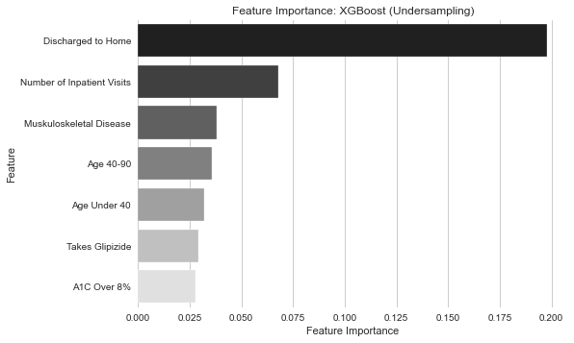
Model Results - Clinical Interpretation
Feature Importance
Discharged to Home
Improve discharge instructions or followup
Number Inpatient Visits
Musculoskeletal Disease
Common for Diabetics
Age 40-90
Age Under 40
Takes Glipizide
Lowers blood sugar
A1c Result Over 8%
Indicates poor control of Diabetes

Slide 33
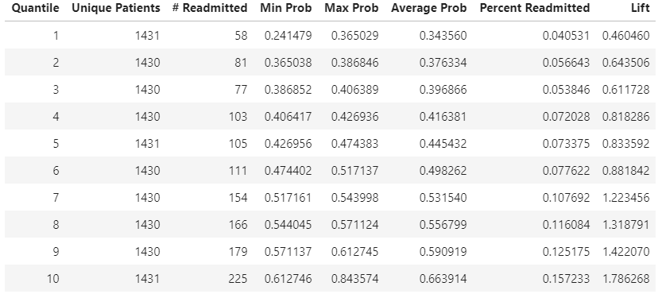

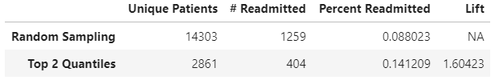
Model Results - Financial Interpretation
Decile Results
Test results were sorted to 10 quantiles of equal size
As the number of readmitted increases, the percent of readmitted increases
Takeaway
Target the top 2 quantiles for intervention for an increase from 0.09 to 0.14 over random sampling
Model has 1.786 lift for top quantile
1.604 lift for top two quantiles

Slide 34
Model Results - Business Outcome Summary
Clinical
Clinicians should target patient characteristics via feature importance for further research into preventative medicine
Patient Characteristics to Target:
Discharged to Home
High A1c (Over 8%)
Aged 40-90
High number of inpatient visits
Musculoskeletal Disorders
Financial
Hospital finance department should target the top quantile(s) of patients scored by our model with the highest chance of readmission rather than a random sampling
Intervention Targeting Priority:
Target the top quantile for max cost efficiency: 15.7% readmitted with 1.78 lift
Target the top 2 quantiles for larger patient group: 14% readmitted with 1.6 lift

Slide 35
Future Project Goals
Project Updates
Exploring other models and techniques to correct for data imbalance and higher predictive accuracy
Future Projects
Applying these techniques to analyze readmission rates of other populations
Sourcing intervention efficacy rates and the cost of intervention to model the financial impact of such models as ours on hospitals or clinical care institutions

Slide 36
Thank You
Questions?

